Slide 1

Virtualization Technologies for
Cloud Computing
Dr. Sunirmal Khatua
Presented By
Visvesvaraya Young Faculty Fellow, Govt. of India
Assistant Professor, Dept. of CSE, University of Calcutta, India

Slide 2
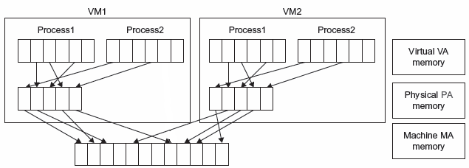
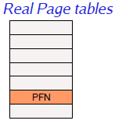
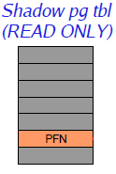


Memory Virtualization
VM Isolation through Shadow Paging
Guest OS
Trap
Write
Hypervisor
Virtual Machine
Machine Memory

Slide 3
Memory Virtualization
Content based Page Sharing
VM1
VM2
OS Kernel
OS Kernel
Machine Memory
Hypervisor
Scan
Hash value

Slide 4
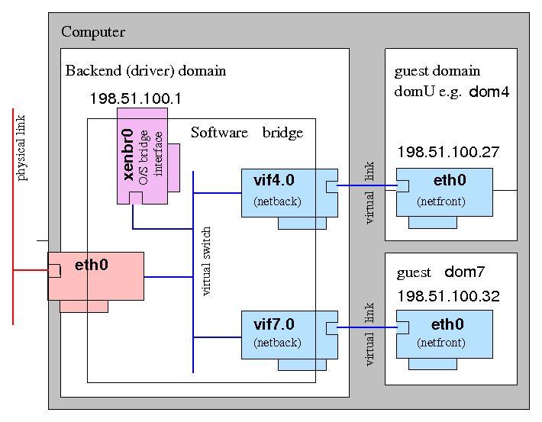
Network Virtualization

Slide 5

Virtual Machine Migration
Cold Migration
Energy Efficiency
Guest OS
Guest OS
Shutdowm VM on Host 1 and Restart on Host 2
Virtualized
Hardware
Load Balancing
Virtualized
Hardware
Virtual Machine
Virtual Machine
Warm Migration
Maintenance
Virtual Machine Monitor
(Hypervisor)
Suspend VM on Host 1, Copy and Resume on Host 2
Virtual Machine Monitor
(Hypervisor)
Blade Server
Blade Server
Physical
Hardware
Live Migration
Physical
Hardware
Recovery from Host Failure
Copy VM state to Host 2 while VM continues to run

Slide 6
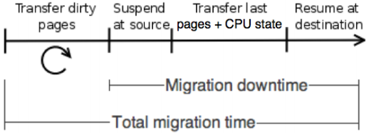
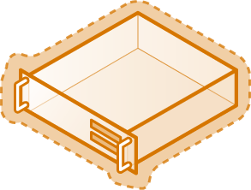

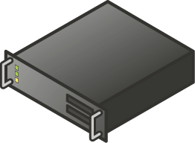
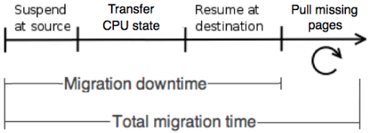

Live VM Migration: How does it Work?
Create VM on target server
Pre-Copy Approach
Copy memory pages from the source to the target.
Final state transfer
Pause virtual machine
Move storage connectivity from source host to target host.
Run new VM on target; Delete VM on source
Post-Copy Approach
Host 1
Host 2
Blue = Storage
Red = Networking
Shared Storage

Slide 7
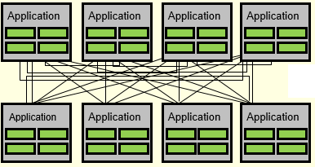

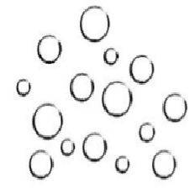
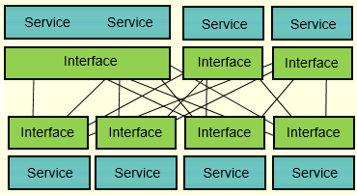
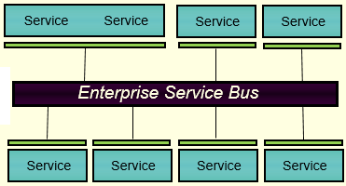
Distributed Computing for Monolithic Applications towards Microservices
Monolithic
Application
Microservices

Slide 8
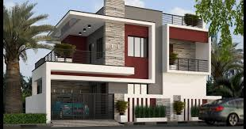
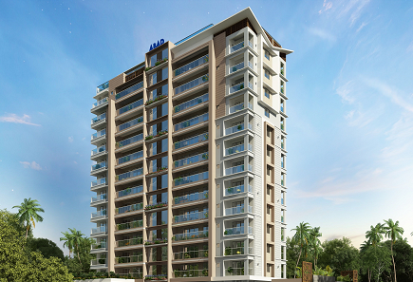
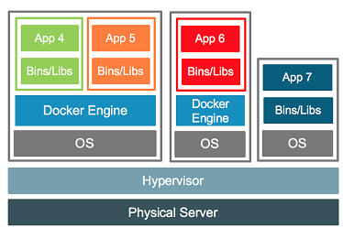
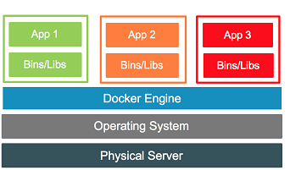
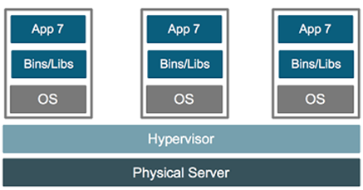
Container for Microservices
Microservices

Slide 9
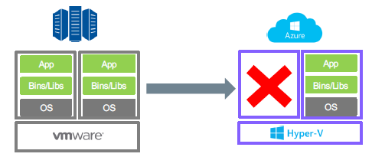
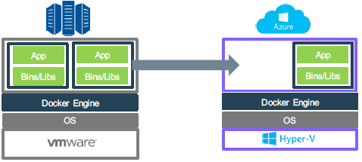
Container for Microservices
Microservices

Slide 10
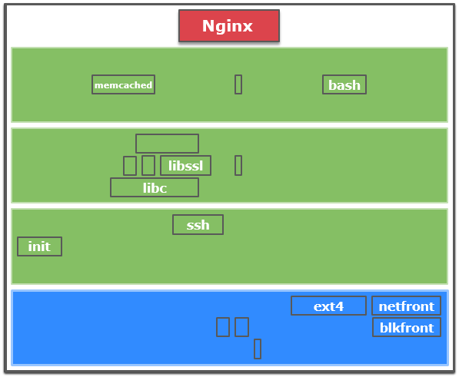
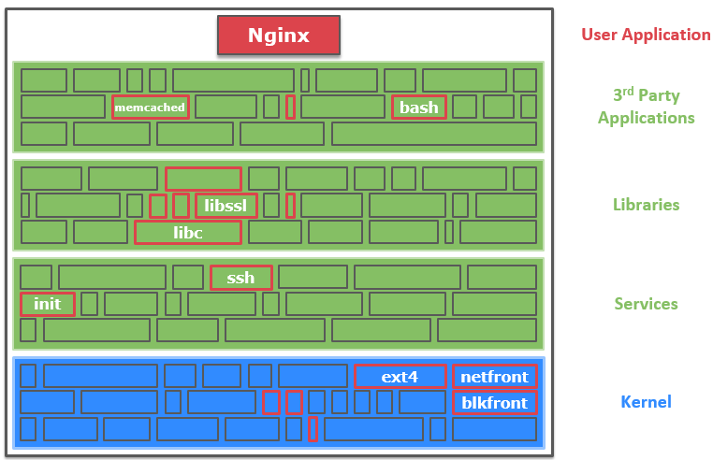
Unikernel for Microservices
Unikernels are specialised, single address space machine images constructed by library operating systems
Similar to One VM for One Service
Guest OS
Virtualized
Hardware
Microservices
Virtual Machine
Virtual Machine Monitor
(Hypervisor)
Blade Server
Physical
Hardware

Slide 11
Unikernel for Microservices
Unikernels are specialized, single address space machine images constructed by library operating systems
Similar to One VM for One Service
Advantages
Few kilobytes in size, so very fast to boot.
No context switch
Runs on hypervisor, container or bare metal
Small attack surface

Slide 12
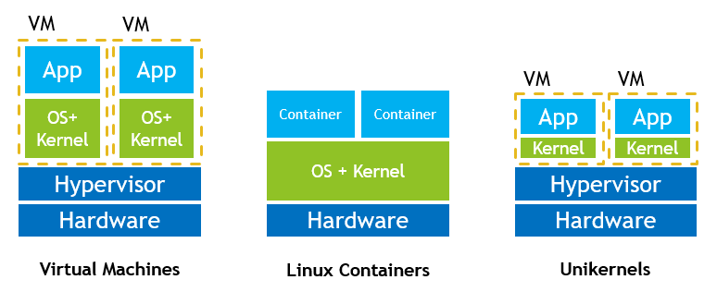
VM vs Container vs Unikernel

Slide 13
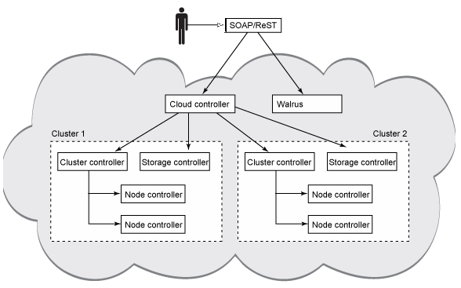
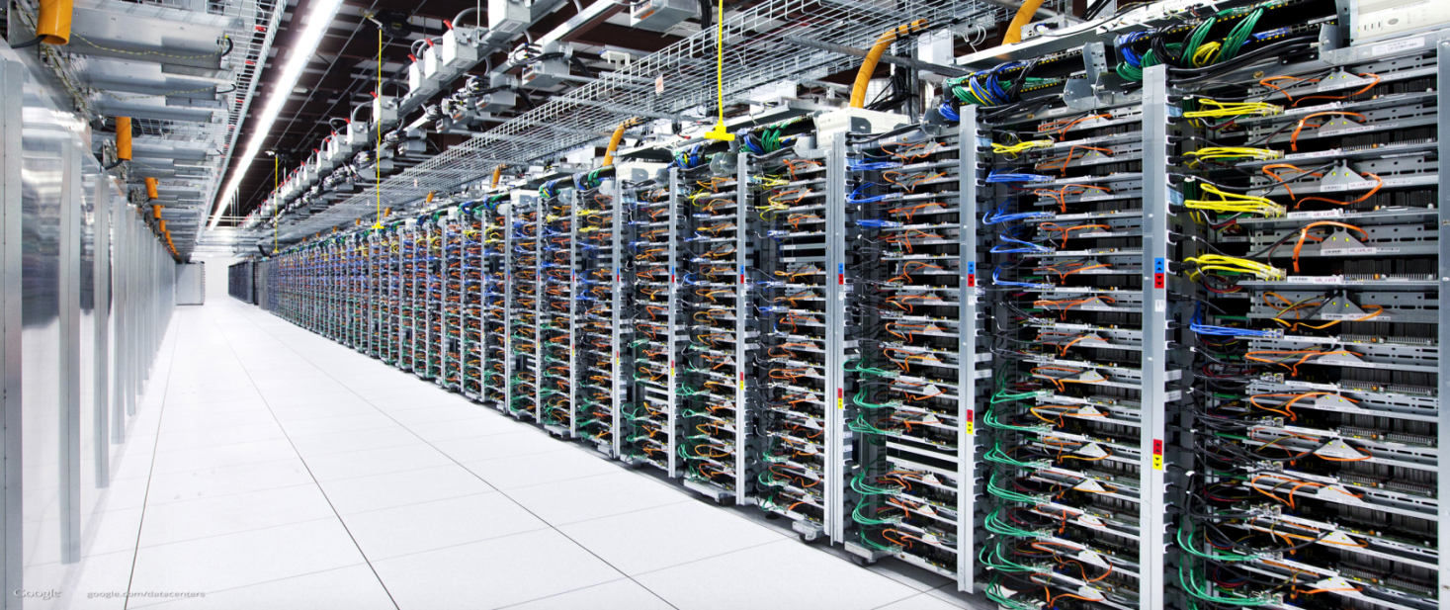

Middleware for Largescale Computation : Cloud Computing

Slide 14
Thank You for Listening
Questions?

